Slide 1
Lesson 1: What is a computer network?
Mack 2023
Notes:
Last updated 30-11-2021
Resources are updated regularly — the latest version is available at: ncce.io/tcc.
This resource is licensed under the Open Government Licence, version 3. For more information on this licence, see ncce.io/ogl.

Slide 2

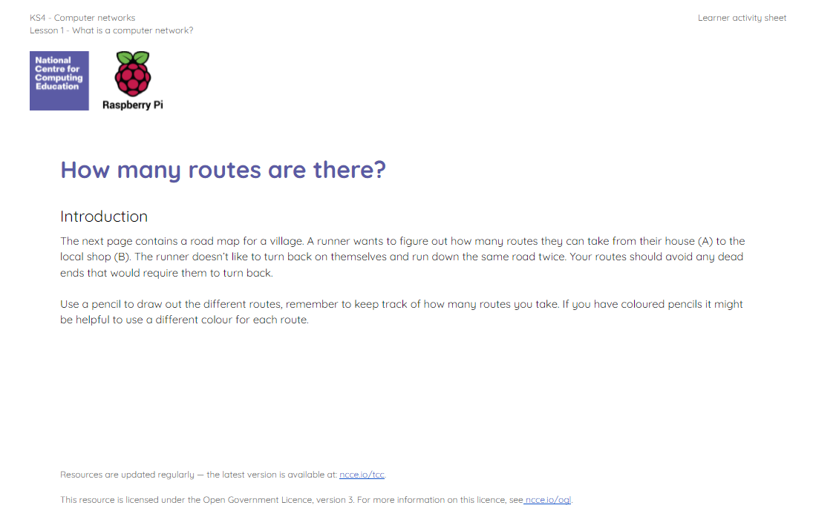
How many routes are there?
Starter activity
The activity sheet contains a road network for a village. A runner wants to figure out how many routes they can take from their house (A) to the local shop (B).
The runner doesn’t like to turn back on themselves and run down the same road twice. Your routes should avoid any dead ends that would require them to turn back.

Slide 3
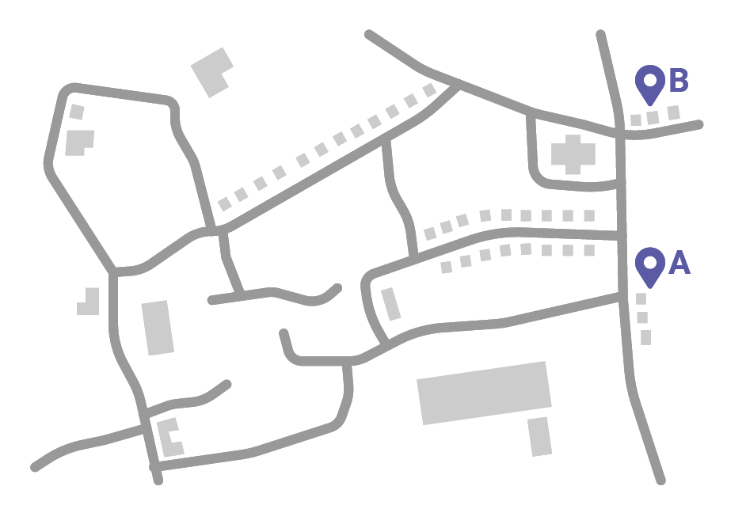
How many routes were there?
Starter activity

Slide 4
How many routes were there?
Starter activity
Routes
1

Slide 5
How many routes were there?
Starter activity
Routes
2

Slide 6
How many routes were there?
Starter activity
Routes
3

Slide 7
How many routes were there?
Starter activity
Routes
4

Slide 8
How many routes were there?
Starter activity
Routes
5

Slide 9
How many routes were there?
Starter activity
Routes
6

Slide 10
How many routes were there?
Starter activity
Routes
7

Slide 11
How many routes were there?
Starter activity
Routes
8

Slide 12
How many routes were there?
Starter activity
Routes
9

Slide 13
How many routes were there?
Starter activity
Routes
10

Slide 14
How many routes were there?
Starter activity
Routes
11

Slide 15
How many routes were there?
Starter activity
Routes
12

Slide 16
How many routes were there?
Starter activity
Routes
13

Slide 17
How many routes were there?
Starter activity
Routes
14

Slide 18
How many routes were there?
Starter activity
Routes
15

Slide 19
How many routes were there?
Starter activity
Routes
16

Slide 20

Did you get more than 17?
Starter activity
Routes
17

Slide 21

Lesson 1: What is a computer network?
Objectives
In this lesson, you will:
Define a computer network
Discuss the advantages and disadvantages of computer networks
Describe the role of a computer in a peer-to-peer network

Slide 22
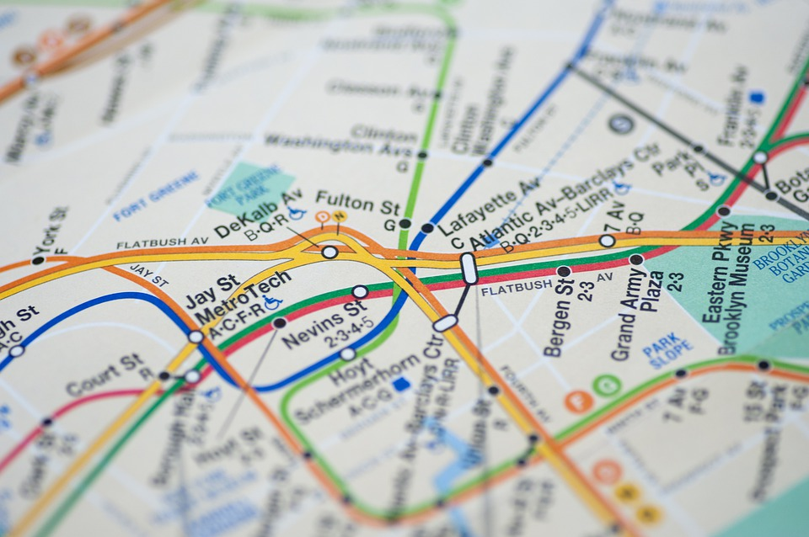
Examples of networks
Activity 1
You can see examples of networks all around you. Transport networks can include routes for:
Trains
Trams
Boats
Planes
Cars / Lorries
Notes:
Image source: https://pixabay.com/photos/nyc-metro-plan-map-new-york-4328896/

Slide 23
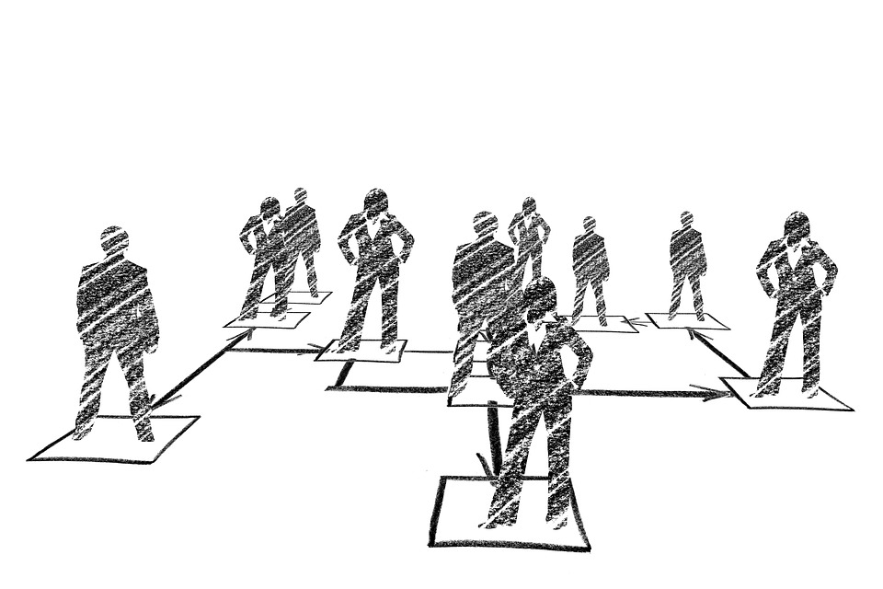
Examples of networks
Activity 1
You can see networks in businesses when you look at the hierarchy of roles in the company.
Everyone in a company is connected through line managers, directors, and executives.
Notes:
Image source: https://www.pxfuel.com/en/free-photo-ojqgo

Slide 24
Examples of networks
Activity 1
Schools can also form networks when they join with other schools to share ideas and resources.
🏫
🏫
🏫
🏫
🏫
Notes:
Image source: https://www.iemoji.com/view/emoji/114/travel-places/school

Slide 25
Drawing a network
Activity 1
All networks can be visualised (drawn) using a graph made up of nodes and edges.
Here is the village map again.

Slide 26
Drawing a network
Activity 1
This whole map can be visualised using nodes and edges.

Slide 27
Drawing a network
Activity 1
The nodes are the circles and these represent the items that form the connections.
Nodes can be used to represent many things. You will discover more examples throughout this unit.

Slide 28
Drawing a network
Activity 1
The edges are the lines between the nodes and these represent the connections.

Slide 29
A computer network
Activity 1
A computer network is more than one computer connected together and able to share resources.
You can represent computer networks using graphs like these too.

Slide 30
Think, write, pair, share
Activity 1
Question
Why do you think it might be a good idea to connect computers together and share resources?

Slide 31
Think, write, pair, share: solutions
Activity 1
You can share documents easily
Share devices, like printers
Software and storage can be shared across the network
Users can connect with people in other countries
It can be more reliable
Backups can be centralised

Slide 32
Think, write, pair, share
Activity 1
Question
What are the disadvantages of connecting computers across a network?

Slide 33
Think, write, pair, share: solutions
Activity 1
Networks are expensive to set up
Hackers could gain access to an entire network if it isn’t protected
Managing a network requires specialist skills
Managing security over an entire network requires specialist skills
Viruses can be spread through connections

Slide 34

How do computers share resources?
Activity 2
There are two fundamental roles in a computer network.
Role 1
The client, which puts in a request for data.
Role 2
The server, which fulfils that request.
Client
Server
Notes:
Image source: https://pixabay.com/vectors/laptop-pc-computer-technology-2243898/

Slide 35
Two models
Activity 2
The relationship between the client and the server can be organised in different ways.
The most common are:
The client–server model
The peer-to-peer model
Client
Server
Notes:
Image source: https://pixabay.com/vectors/laptop-pc-computer-technology-2243898/

Slide 36
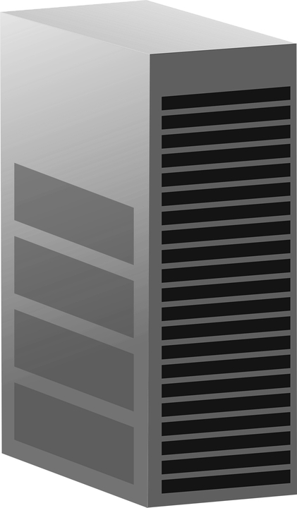
The client–server model
Activity 2
Server
In the client–server model, a dedicated server will fulfil requests for one or more clients.
You will learn more about this next lesson.
Client
Client
Client
Notes:
Image source: https://pixabay.com/vectors/server-computer-mainframe-146615/
Image source: https://pixabay.com/vectors/laptop-pc-computer-technology-2243898/

Slide 37
The peer-to-peer model
Activity 2
With a peer-to-peer model, each device can perform the role of the client and the server.
Server
Server
Server
Client
Client
Client
Server
Server
Server
Client
Client
Client
Notes:
Image source: https://pixabay.com/vectors/laptop-pc-computer-technology-2243898/

Slide 38

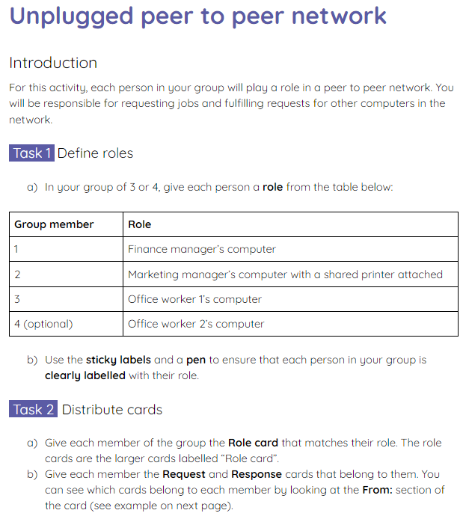
The peer-to-peer model
Activity 2
In groups of 3, you will take part in an unplugged activity where you act out various scenarios performed using the peer-to-peer model.
Read your instructions on the activity 2 sheet carefully to set up the task. Scenario one will be completed together using the following slides.

Slide 39
Scenario 1
Activity 2
Office worker 1 sends a request for the file Company_logo.png
Marketing manager receives the request and sends the file Company_logo.png
Finance manager sends a print request for the file Annual_budget.xls
Marketing manager actions the print request from Finance manager
Notes:
Image source: https://pixabay.com/vectors/laptop-pc-computer-technology-2243898/

Slide 40
Scenario 1
Activity 2
(optional) Office worker 2 sends a request for the file Website_animation.gif
(optional) Marketing manager receives the request and sends the file Website_animation.gif
Office worker 1 sends a print request for the file Welcome_letter.doc
Marketing manager actions the print request from Office worker 1
Notes:
Image source: https://pixabay.com/vectors/laptop-pc-computer-technology-2243898/

Slide 41
Scenario 1
Activity 2
Marketing manager sends a request for the file Customer_database.db
Finance manager receives the request and sends the file Customer_database.db
Marketing manager requests to print Company_logo.png
Marketing manager actions the request to print Company_logo.png
Notes:
Image source: https://pixabay.com/vectors/laptop-pc-computer-technology-2243898/

Slide 42
The peer-to-peer model
Activity 2
Now complete scenarios two and three in your individual groups.
After completing the scenarios, reflect on the advantages and disadvantages of using the peer-to-peer model.

Slide 43
Advantages and disadvantages
Activity 2
Choose one person from your group to share the advantages and disadvantages that you considered whilst completing the activity.
Notes:
Image source: https://pixabay.com/vectors/laptop-pc-computer-technology-2243898/

Slide 44
Advantages and disadvantages: model answers
Activity 2
Advantages:
Clients are not dependent on one single server
Resources can be shared between computers (e.g. printers)
It doesn’t require expensive equipment to set up
If more than one computer in the network hosts a file, then the client can request it from the device that is closest
Notes:
Image source: https://pixabay.com/vectors/laptop-pc-computer-technology-2243898/

Slide 45
Advantages and disadvantages: model answers
Activity 2
Disadvantages:
Using a shared peripheral, like a printer, can lead to a computer slowing down whilst processing many requests
If a host computer breaks down, this can cause files or peripherals that are hosted by it to be unavailable
There is no central backup system
There is no central way to provide security for the network
Notes:
Image source: https://pixabay.com/vectors/laptop-pc-computer-technology-2243898/

Slide 46
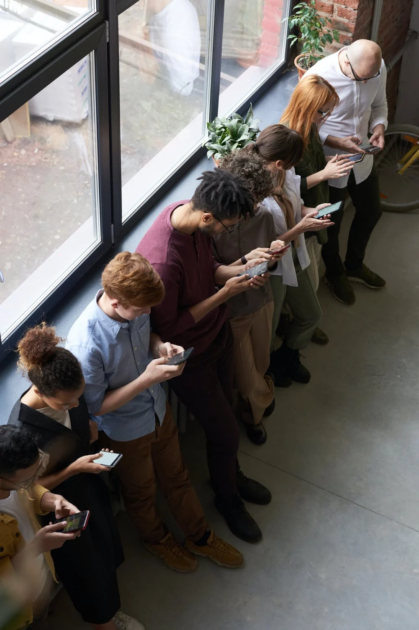
Peer-to-peer network: real-world examples
Activity 3
A temporary peer-to-peer network can be set up between trusted friends or colleagues to share files between devices.
Modern smartphones typically have features that allow you to set up temporary connections to share photos, videos, or document files.
Notes:
Image source: https://www.pexels.com/photo/people-holding-their-phones-3184435/

Slide 47
Peer-to-peer network: real-world examples
Activity 3
Temporary peer-to-peer connections can also be created using other devices like computers and laptops to share files.
Notes:
Image source: https://www.pexels.com/photo/people-holding-their-phones-3184435/

Slide 48

Peer-to-peer network: real-world examples
Activity 3
Another example is streaming and on-demand TV services.
The peer-to-peer model can be used to make streaming faster for the users and reduce the load on the provider’s network.
Notes:
Image source: https://www.pexels.com/photo/black-children-using-touchpad-of-laptop-on-sofa-6437861/

Slide 49

Peer-to-peer network: real-world examples
Activity 3
Streaming services provide video and music on demand to millions of users on a daily basis.
Traditionally, the video was held in one location and this was delivered separately to each individual user of the service.
Streaming service

Slide 50
Peer-to-peer network: real-world examples
Activity 3
With millions of users watching videos at the same time, this put huge pressure on the streaming providers.
The quality was poor and there was often a long wait for videos to be displayed.
Streaming service

Slide 51
Peer-to-peer network: real-world examples
Activity 3
Users now expect high-quality video content to be delivered to them at high speed.
To enable this to happen, the peer-to-peer model was introduced.
Streaming service

Slide 52
Peer-to-peer network: real-world examples
Activity 3
Instead of all the users accessing the content directly from the streaming service, the content could now be delivered by a local peer.
Streaming service
peer
peer

Slide 53
Peer-to-peer network: real-world examples
Activity 3
The streaming service detects local users that are watching the same video.
A peer-to-peer connection is established to allow the data to be sent from one peer to another.
This means that data has less distance to travel, making the stream faster.
It also takes some of the strain from the streaming service provider.
Streaming service
peer
peer

Slide 54
Peer-to-peer network: real-world examples
Activity 3
If the connection is lost between peers, then another connection is found and the stream continues.
Streaming service
x
peer

Slide 55
Peer-to-peer network: real-world examples
Activity 3
It is important to note that the entire video will not be sent to the user in one single file.
You will learn more about how data is transferred later on in this unit.
Streaming service
x
peer

Slide 56
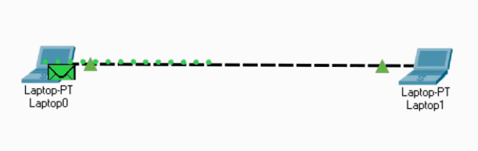
Peer-to-peer network: simulation
Activity 3
A free networking simulation package has been created called Packet Tracer.
You will be using this throughout this unit to develop your understanding of how networks work.
The next slide shows an animation of two laptops in a peer-to-peer network. One is checking that they have a connection with the other.
Notes:
Image source: Packet tracer screenshot

Slide 57
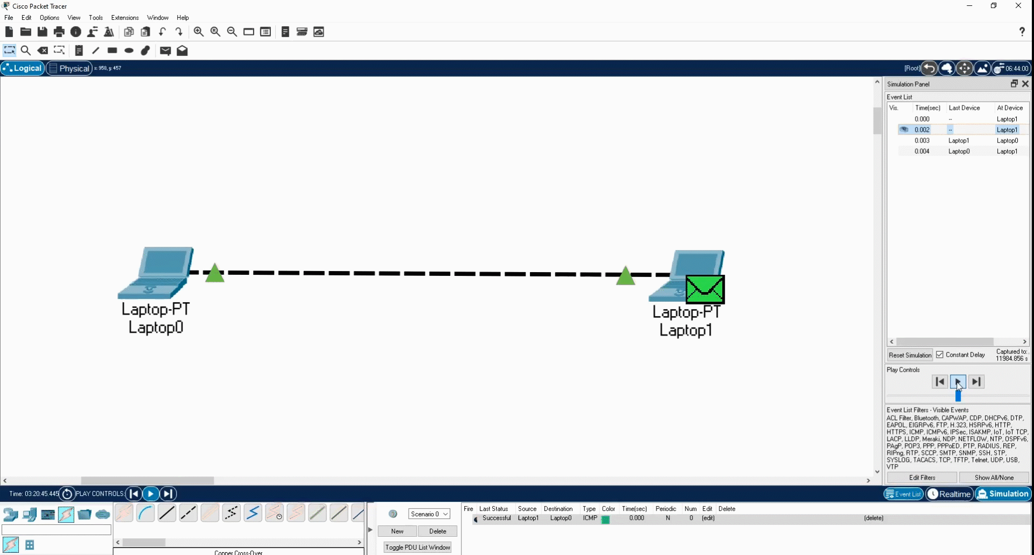
Peer-to-peer network: simulation
Activity 3
Notes:
Image source: Packet tracer screenshot

Slide 58
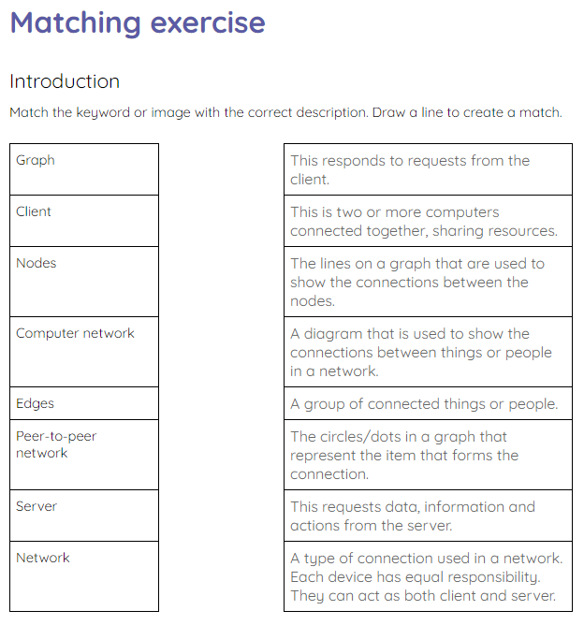
Matching exercise
Exit Ticket
Complete the matching exercise on the activity sheet to match the keywords to the descriptions.

Slide 59
Next lesson
Summary
In this lesson, you…
Defined a computer network
Discussed the advantages and disadvantages of computer networks
Described the role of a computer in a peer-to-peer network
Next lesson, you will…
Explore the client–server model

